Slide 1


Watch In Motion
Jack Leshem, Thomas Kelly, Michael Greer, Daniel Pollak

Slide 2
Our Mission Statement
“Our mission is to create an inexpensive, automated health alert device. We aimed to eliminate monthly cost for passive health alert wearables. We wanted to make these sorts of devices more accessible to lower income households without sacrificing performance.”
- Watch in Motion

Slide 3
Development Process
Passive health monitoring equipment
APIs we had access to
Hardware we had access to
Impact on consumer base

Slide 4
Our Implementation
Wearable hardware:
WiFi enabled microchip
Accelerometer
Touch sensor, buttons, LEDs, Buzzer
If a “fall” is detected, wearable alerts server
Flask server sends request to Cisco Tropo
Tropo sends sms messages to emergency contacts

Slide 5
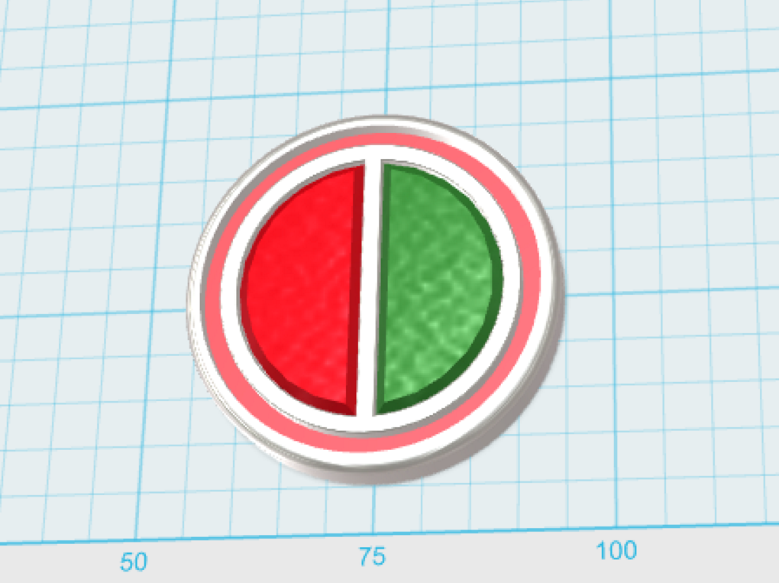
Future Design
Precise location
Smaller form factor
Lower overall costs
Tactile feedback
Advanced communications
Heart Rate monitor
Watch Face

Slide 6
Projected Hardware Cost
Component | Cost ($)
Microcontroller (ESP8266) | 5.00
Single Input Capacitor | 0.30
Accelerometer | 2.38
Buzzer | 0.20
Button (2) | 0.20
RGB LED Package (12) | 7.08
Battery | 2.00
Case and Band | 3.00
TOTAL | 20.16

Slide 7
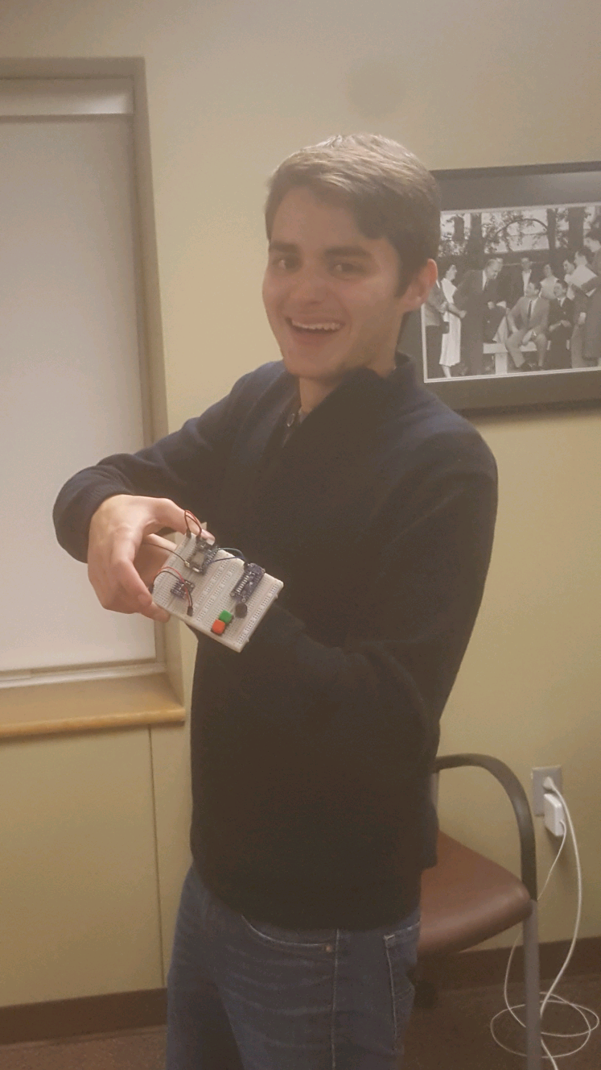
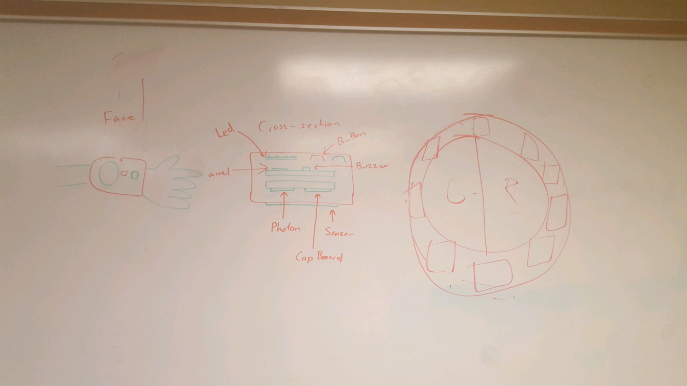
Questions, Comments, or Concerns?
Michael with beginning prototype
Complete watch implementation design

